Slide 1
HNDIT1107 Mathematics for IT
Week 2 - Sets & Basic Set Operations

Slide 2
Finite Sets
a finite set is a set that has countable number of elements.
Eg: A = {1,3,5,7,9}

Slide 3
Infinite Sets
An infinite set is a set that is not a finite set.
Infinite sets may be countable or uncountable.
Eg: A = { all the negative numbers}
B = { all real numbers }

Slide 4
Disjoint sets
If A and B have no common elements they are said to be disjoint i.e. A ∩ B = φ
U
A
B

Slide 5
Empty set (Null set)
The set that has no elements is called the empty set
It is denoted by φ or { }
The empty set is a subset of every set including itself
Eg: A = { x: x²=4 & x is an odd integer}

Slide 6
Universal Set
The members of all the investigated sets in a particular problem usually belongs to some fixed large set. That set is called the universal set
Eg: U = {all students at ATI}
some subsets:
A = {all HNDIT students}
B = {first year students}

Slide 7
Venn Diagrams
A pictorial way of representing sets
Various sets are represented by circles inside a big rectangle
Eg: A = { a,e,i,o,u}
complement of A
A
a e
i
o u

Slide 8
The universal set is represented by the interior of a rectangle & other sets are represented by disks within the rectangle
universal set
U
A
B

Slide 9
Set Operations
There are several fundamental operations for constructing new sets from given sets.
Union
Intersection
Difference
Symmetric difference
compliment

Slide 10
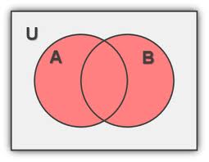
Union
Union of two sets A & B is the set of all elements which belongs to either A or B or both
This is denoted by A ∪ B
A ∪ B = { x: x ∈ A or x ∈ B }

Slide 11
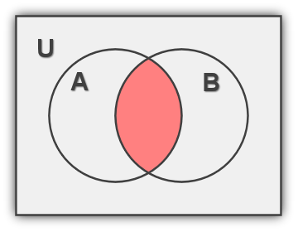
Intersection
Intersection of two sets A & B is the set of all elements which belongs to both A & B
This is denoted by A ∩ B
A ∩ B = { x: x ∈ A and x ∈ B }

Slide 12
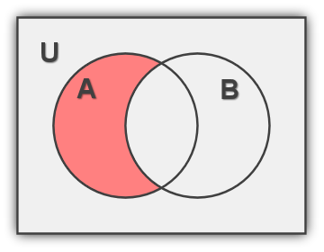
Difference
Difference of two sets A & B is the set of all elements which belongs to A but which does not belongs to B
This is denoted by A\B or A-B
A\B = { x: x ∈ A , x ∉ B }

